Slide 1
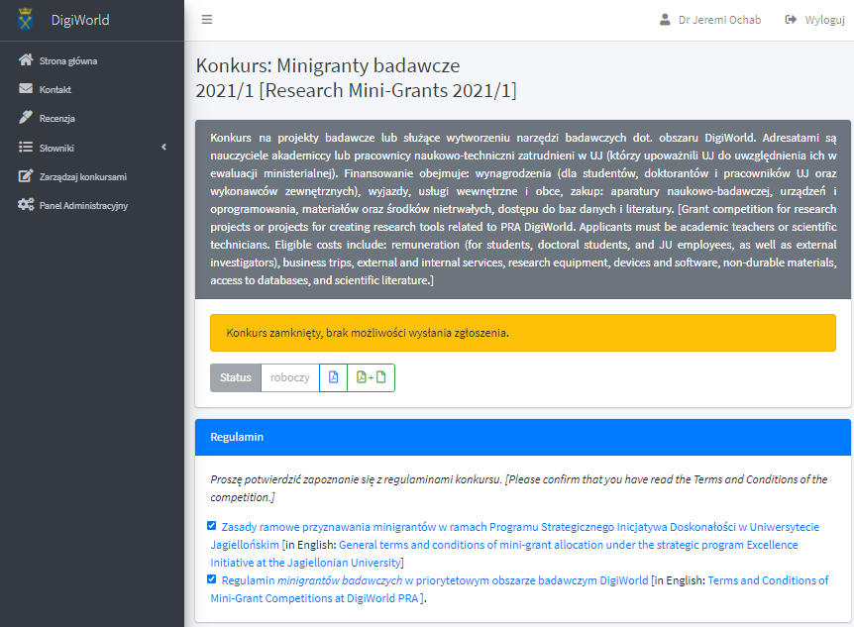

Slide 2
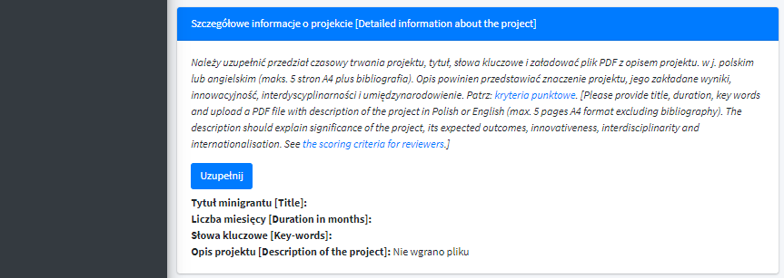

Slide 3
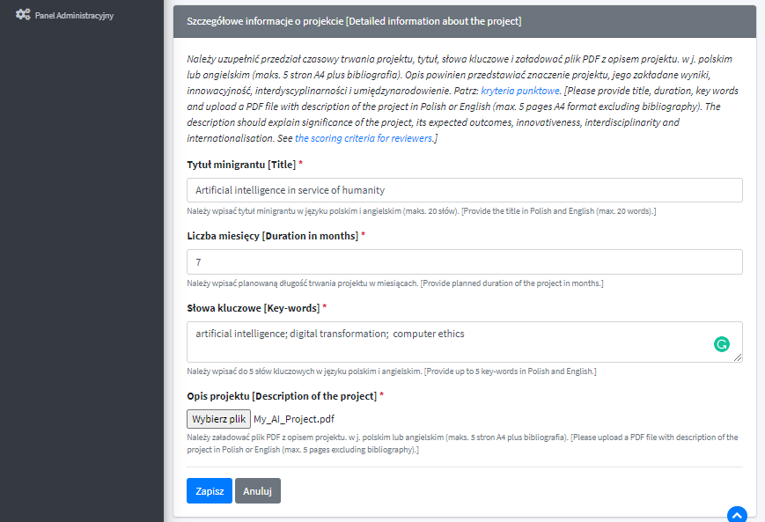

Slide 4
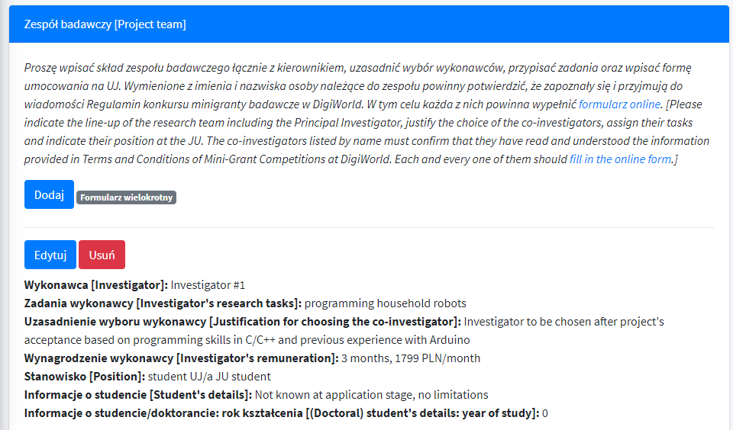

Slide 5
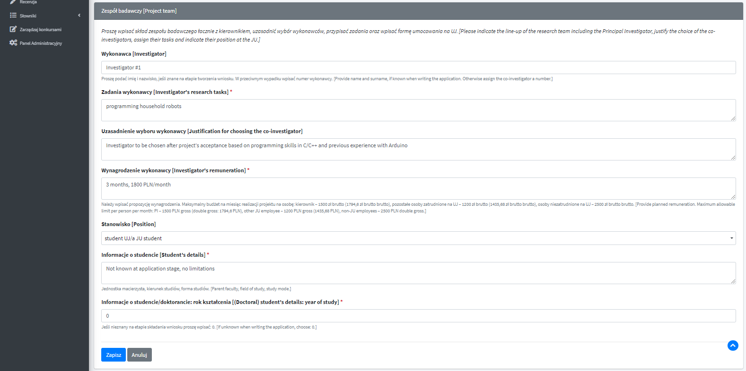

Slide 6
CLICK AGAIN TO ADD MORE INVESTIGATORS
ASK THEM TO FILL IN THE FORM

Slide 7
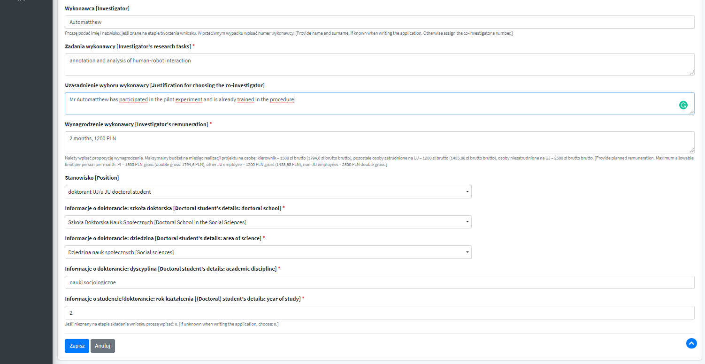
THESE FIELDS ARE CONNECTED

Slide 8
DO NOT FORGET ABOUT YOURSELF!

Slide 9
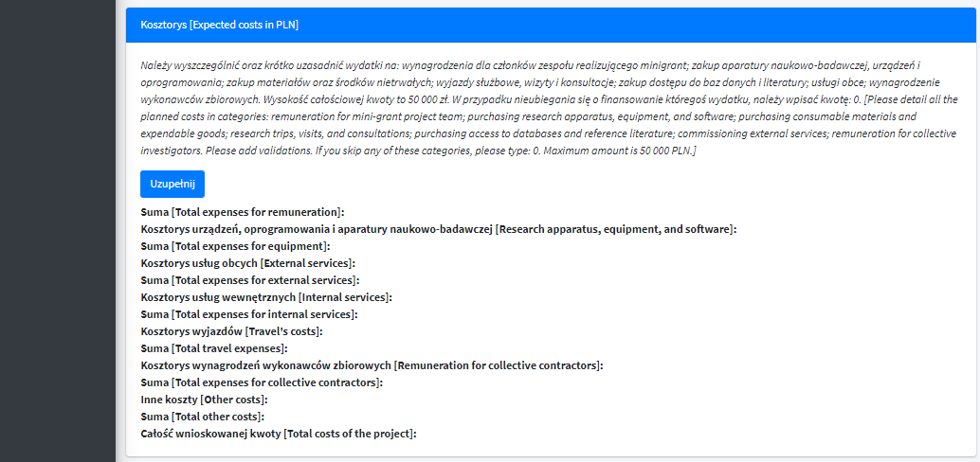

Slide 10
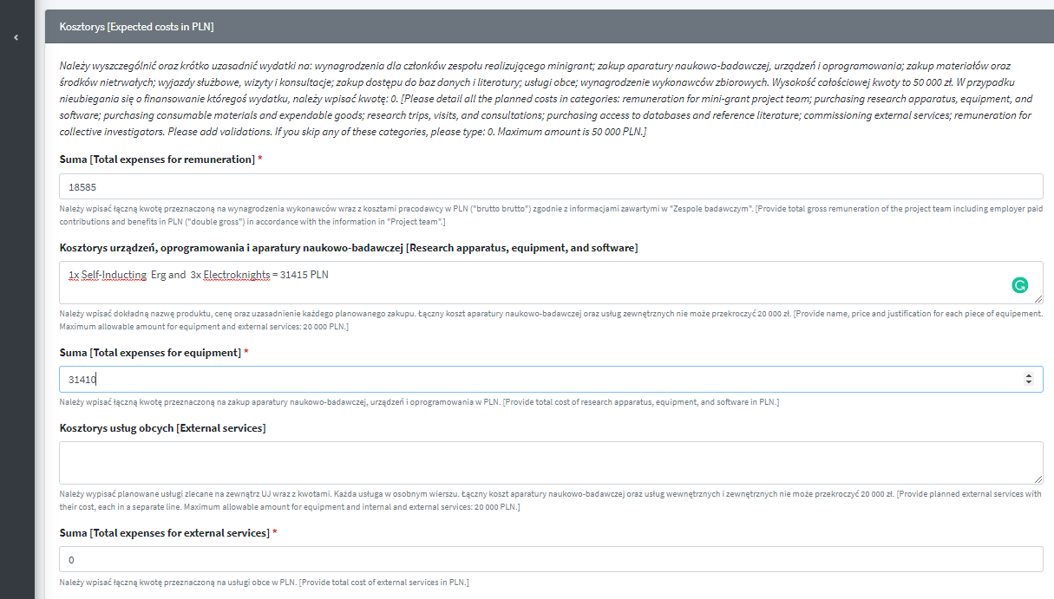

Slide 11
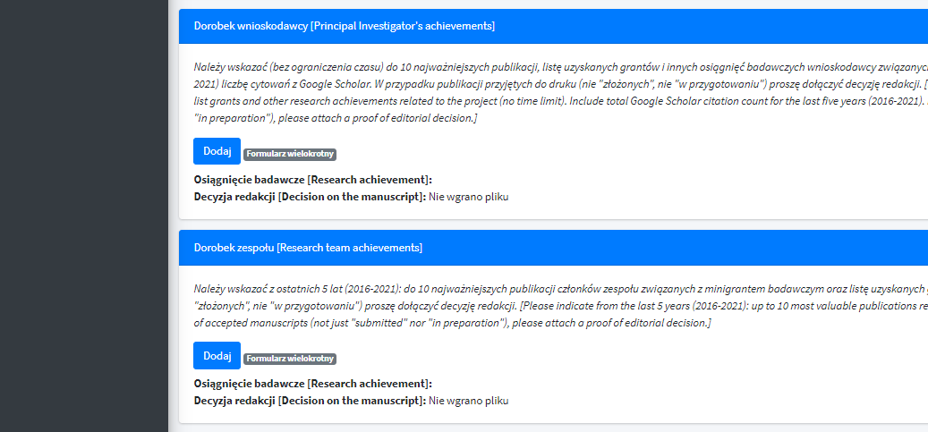
ADD MULTIPLE ITEMS
ADD MULTIPLE ITEMS

Slide 12
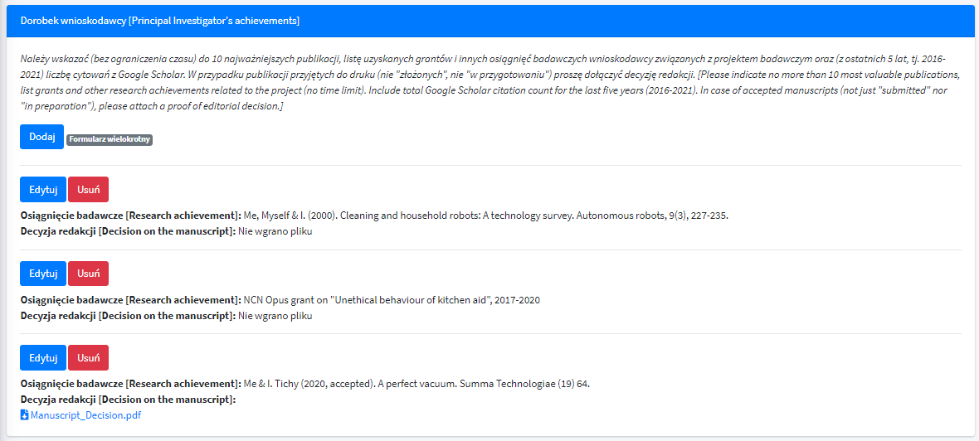

Slide 13
